Slide 1


Slide 2
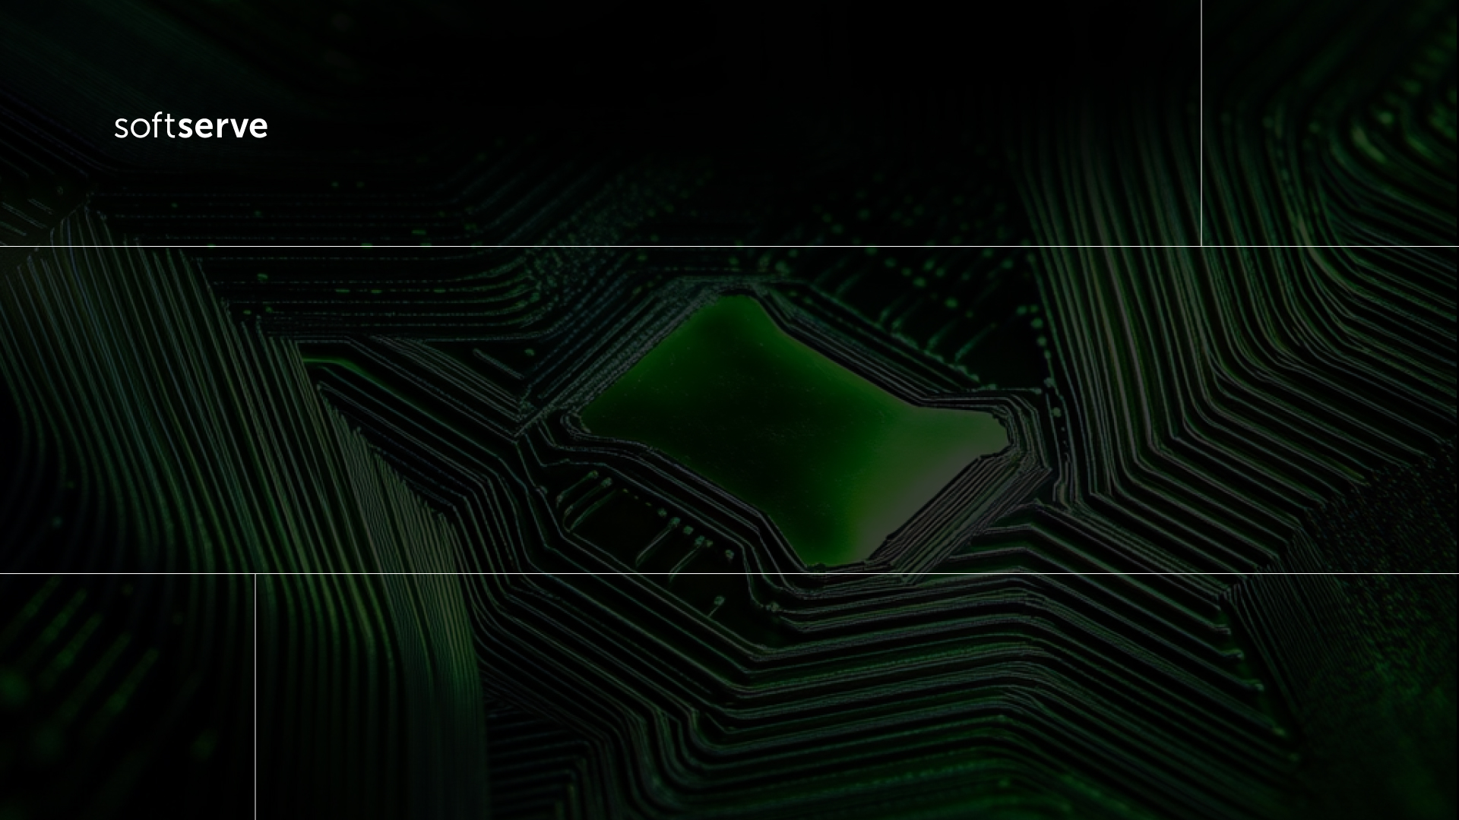
Crunching GPUs easily using CUDA Python
León Jaramillo

Slide 3

AGENDA
01
04
Are really GPUs a big thing?
What is CUDA?
02
CPUs or GPUs?
05
What is CUDA Python?
03
GPU architecture
06
Call to Action

Slide 4
Are really GPUs a big thing?

Slide 5

Are really GPUs a big thing?
Agentic AI: https://trends.google.com/trends/explore?date=today%205-y&q=Agentic%20AI&hl=en
GPU performance: https://trends.google.com/trends/explore?date=today%205-y&q=GPU%20performance&hl=en
CUDA: https://trends.google.com/trends/explore?date=today%205-y&q=CUDA&hl=en
All of them: https://trends.google.com/trends/explore?date=today%205-y&q=Agentic%20AI,GPU%20performance,CUDA&hl=en
All of them (CO): https://trends.google.com/trends/explore?date=today%205-y&geo=CO&q=Agentic%20AI,GPU%20performance,CUDA&hl=en

Slide 6
CPUs or GPUs?

Slide 7
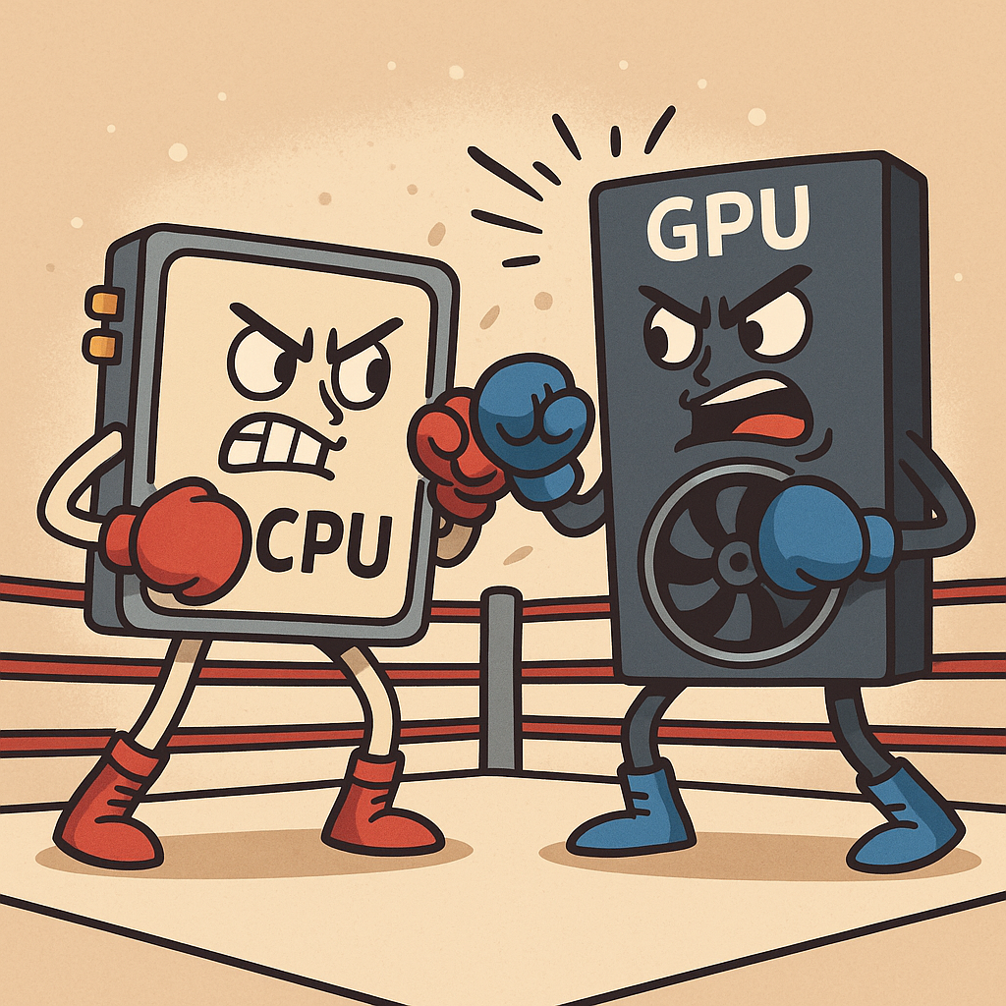
Why bother asking such a question?
This question wasn’t widespread some years ago.
Nowadays, GPUs are more accessible and got more use cases.
But CPUs still play a key role.
Data-intensive applications are surging.
AI and HPC demand huge scalability.

Slide 8
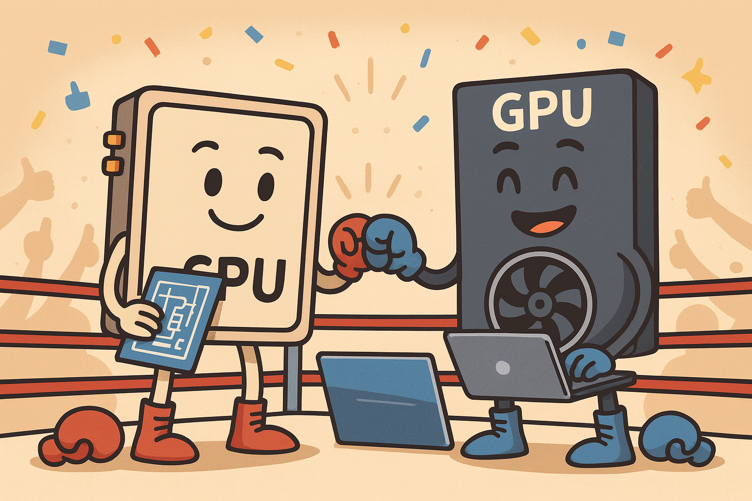
CPUs vs. GPUs
CPUs
Low latency
Highly versatile
Huge potential memory
GPUs
High throughput
Massive parallelism in numeric stuff
Memory transfer overhead

Slide 9
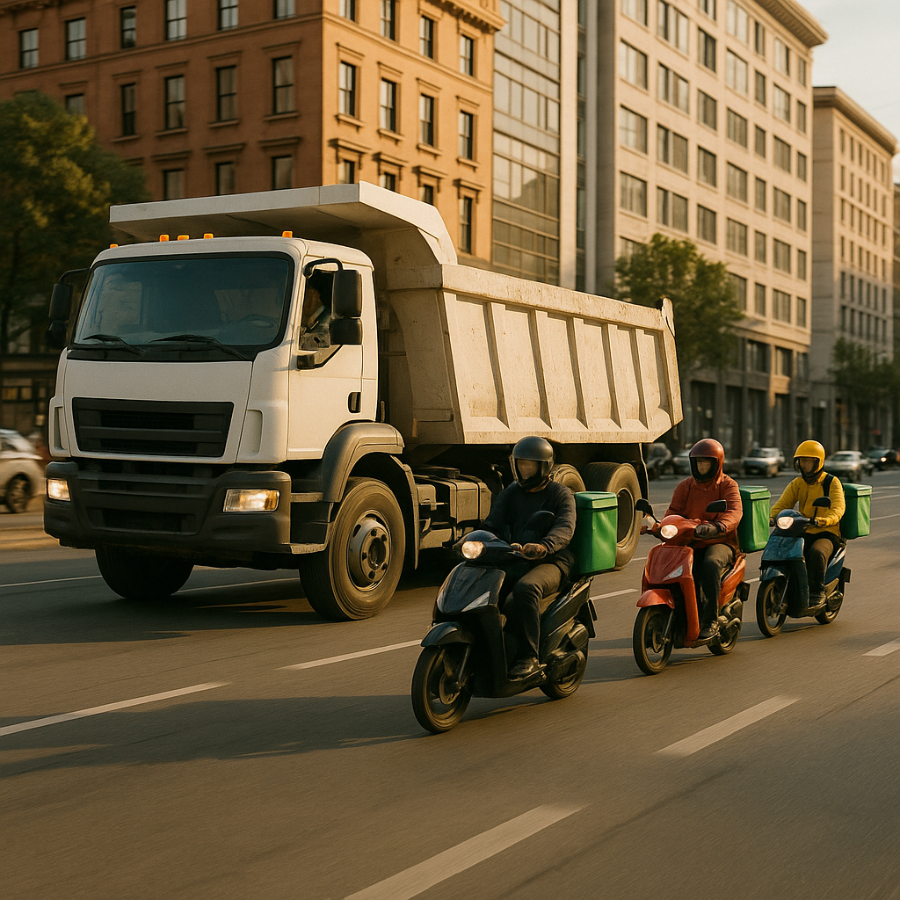
Just a way to see it…
CPUs are like haul trucks.
GPUs are like delivery motorcycles.
Haul trucks can delivery many sorts of goods, all at once.
Delivery motorcycles can deliver only some sorts of goods in a faster pace.
Both types of transportation excel in different scenarios.

Slide 10
GPU Architecture

Slide 11
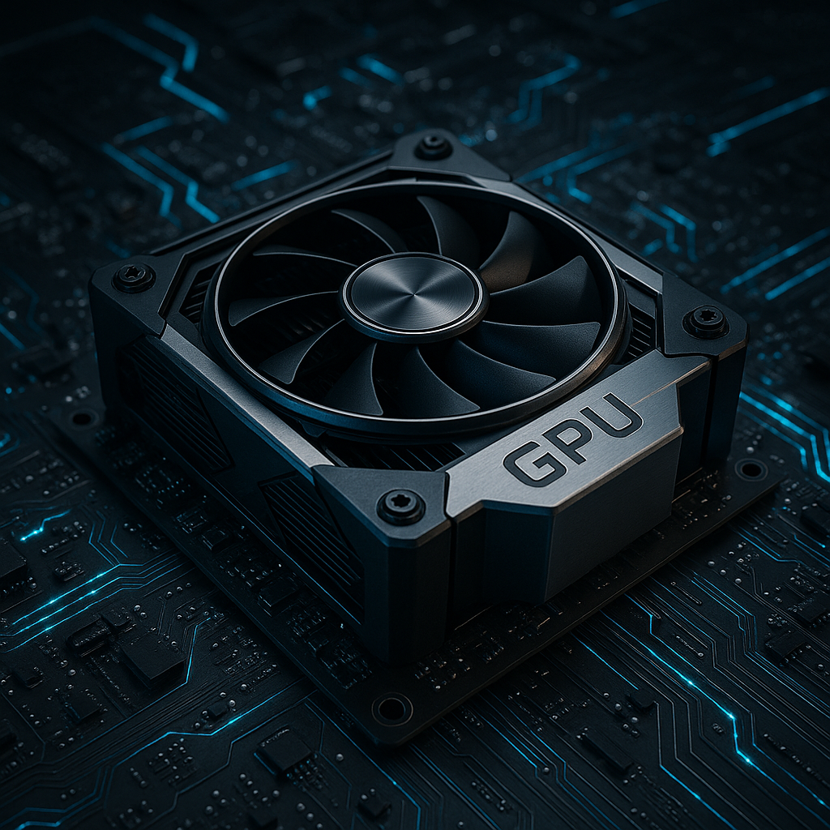
GPU key specifications
GPUs feature thousand of cores, while CPUs have quite a few.
GPUs have some memory capacity, which is lower than CPUs’.
GPUs have simpler and smaller cache hierarchies than CPUs.
GPUs have lower clock speeds than CPUs.
GPUs have a “higher” energy consumption.

Slide 12
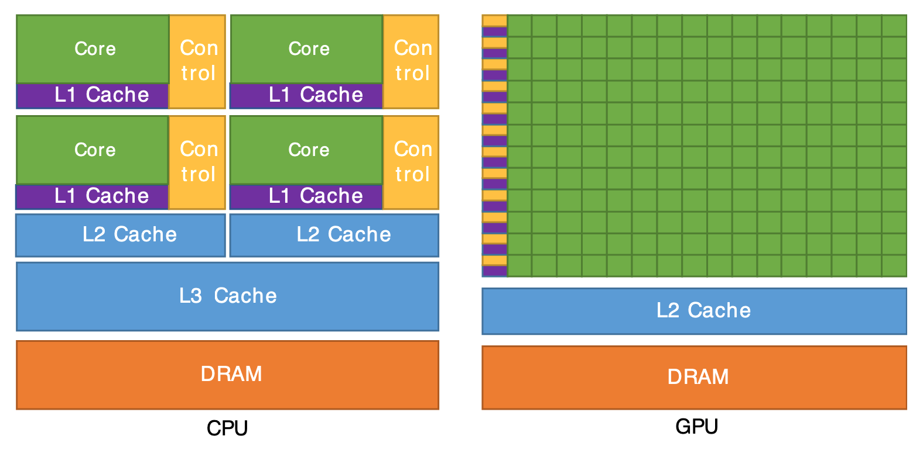
A GPU (and a CPU) looks like this

Slide 13
What is CUDA?

Slide 14
Grid
Block
Thread
So, what is CUDA?
CUDA (Compute Unified Device Architecture) is NVIDIA’s parallel computing platform and API for general-purpose GPU computing.
Provides a programming model and a rich set of libraries to offload computations to the GPU.

Slide 15
GPU programming model
Logical Hierarchy
Kernel: The CUDA function that runs on the GPU.
Grid: Collection of blocks launched to execute the kernel (SIMT).
Block: A collection of threads with a shared memory.
Thread: Runs the kernel function on specific data (can be thousands).
Physical Hierarchy
GPU: It’s the whole hardware device.
Streaming Multiprocessor (SM): A GPU has many of them, executing many blocks in parallel as scheduled.
Warp: A SM has many warps, being its basic unit, with 32 threads each, executing instructions in lockstep.
CUDA Core: Executes threads.

Slide 16
A CUDA kernel
When using CUDA, you write a kernel, which can be launched adnd therefore executed on thousands of threads by CUDA cores, reaching massive throughput:
__global__ void vec_add(const float* a, const float* b, float* c, int n) {
int i = blockIdx.x * blockDim.x + threadIdx.x; // global thread id
if (i < n) c[i] = a[i] + b[i];
}
vec_add<<<blocks, threads>>>(d_a, d_b, d_c, n);

Slide 17
What is CUDA Python?

Slide 18




What is CUDA Python?
CUDA Python refers to the ecosystem of tools and libraries that let us use CUDA through the Python language.
NVIDIA’s CUDA Python initiative aims at providing official Python wrappers for the CUDA APIs.
CUDA Python offers higher level capabilities than raw CUDA, being a bit less performant.

Slide 19
Ladder of abstraction
Deep Learning
PyTorch
TensorFlow
Data Science
RAPIDS (cuDF, cuML, etc.)
Polars
Numeric tasks
CuPy
cuPyNumeric
Custom kernels
Numba
PyCUDA

Slide 20

How to use CUDA Python?
PyTorch
RAPIDS
CuPy
Numba
Just check this repo: https://github.com/leonjaramillo/crunching-gpus
And run the code with a CUDA capable PC or even in Google Colab.

Slide 21
Call to Action

Slide 22

Call to Action
Check if you have access to an NVIDIA GPU.
If so, install its latest driver, and CUDA.
Identify the workloads you can accelerate.
Start experimenting!

Slide 23

THANK
YOU!

